Slide 1
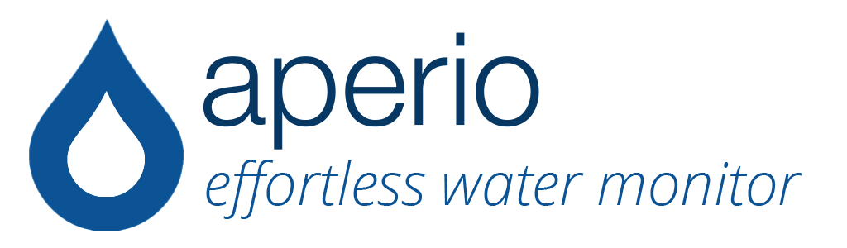

Slide 2
Transparency
Contents of tap water are unclear.
No idea what we are putting into our bodies.
Water may contain bacteria, heavy metals, or arsenic.

Slide 3
Aperio
“Smart” faucet that reveals what is in your tap water.
Concentration of common contaminants
Warns when recommended contamination levels are exceeded - uploads data online.

Slide 4
Target Audience
Desire transparency and an extra layer of knowledge and protection
Willing and able to pay more for peace of mind

Slide 5
Marketing
Gauge Opinion
Website
Data Analytics
Social Networks
http://goo.gl/TDbZAM

Slide 6
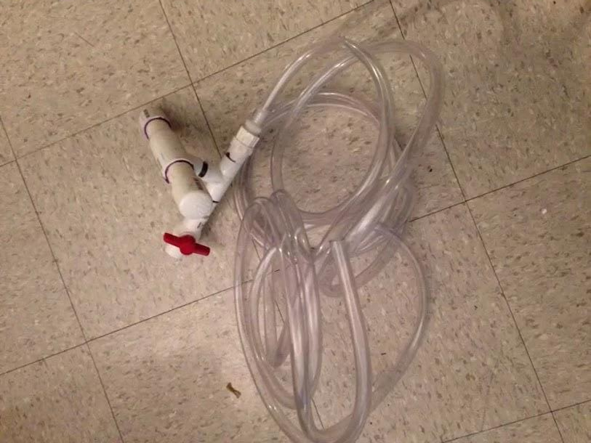

Slide 7
Status and Future Steps
First prototype structure complete
Future Steps:
Continue prototype development
Develop marketing strategy

Slide 8
Visit our Website
http://goo.gl/TDbZAM

